Slide 1

FilterFX
Home
About
Content
Others
Parallel Image & Video Filter Processing
JavaFX GUI • Fork/Join Parallelism • Performance Analysis
Presented to: Dr. Mohamad Aoudi
Hadi Jaber 6353
-
Mohammad Hammoud 6421

Slide 2
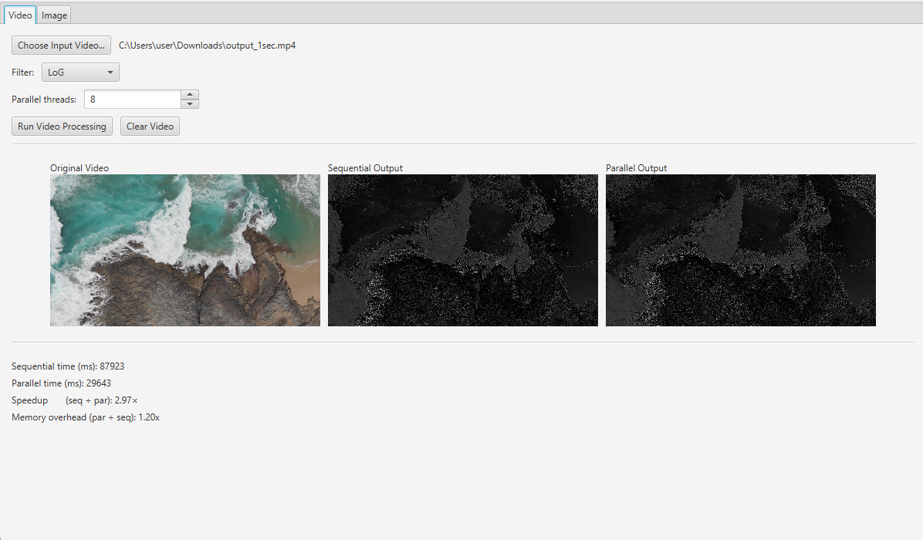
FilterFX
Home
About
Content
Others
Project Overview
Problem: Real-time filtering of large images and videos is compute-intensive.
Goal: Achieve ≥ 3× speed-up over sequential processing on 8 cores.
Approach:
JavaFX GUI for user interaction
Three convolution filters: Blur, LoG, DoG
Sequential baseline vs. Fork/Join parallel version
Report timing, CPU use, and memory overhead
Live JavaFX GUI Demo
• Load Image/Video
• Select Filter & Mode
• Preview & Stats

Slide 3
FilterFX
Home
About
Content
Others
FilterProcessor
Loads image data into an int[]
Applies convolution via a RecursiveAction tree
GUI (JavaFX)
Two tabs: Image & Video
File chooser, filter/mode selectors
Live previews, hover-zoom on images
Buttons to run experiments
System Architecture
VideoProcessor
Captures frames with OpenCV
Hands frames to FilterProcessor
Encodes output with JCodec’s AWTSequenceEncoder

Slide 4
FilterFX
Home
About
Content
Others
FilterProcessor.java

Slide 5
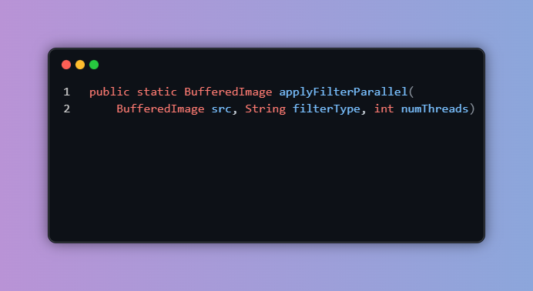
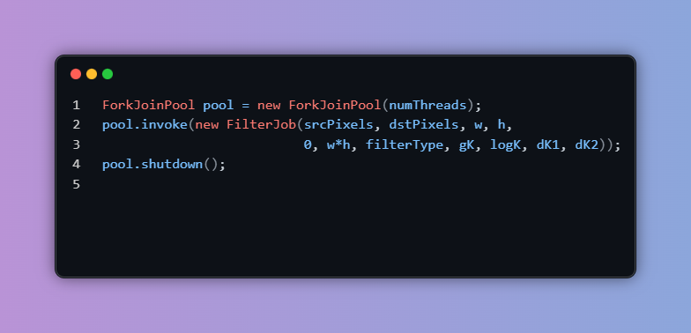
FilterFX
Home
About
Content
Others
Purpose: Parallel 2D convolution (Blur, LoG, DoG) on a BufferedImage using ForkJoin.
FilterProcessor.java
Workflow:
Read all pixels once into int[] srcPixels
Precompute kernels: Mean Blur (23x23), LoG (9×9), DoG (7×7 & 15×15)
Invoke

Slide 6
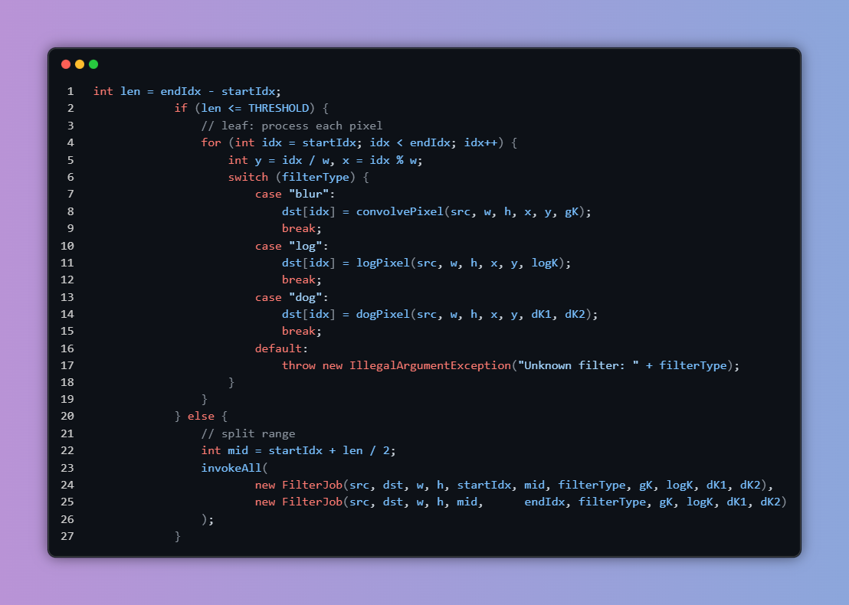
FilterFX
Home
About
Content
Others
This method recursively splits the image’s pixel range into chunks of at most 10 000 pixels. Once a chunk is small enough, it directly applies the chosen filter per pixel; otherwise, it spawns two subtasks to process each half in parallel.
FilterProcessor.java

Slide 7

FilterFX
Home
About
Content
Others
VideoProcessor.java

Slide 8
FilterFX
Home
About
Content
Others
VideoProcessor.java
Purpose: Convert each OpenCV Mat frame into a BufferedImage in TYPE_3BYTE_BGR, ready for parallel filtering.
Workflow:
Load OpenCV native lib in static block
Encode Mat → in-memory JPEG (Imgcodecs.imencode)
Decode JPEG bytes → BufferedImage (ImageIO.read)
Convert format if needed to TYPE_3BYTE_BGR

Slide 9
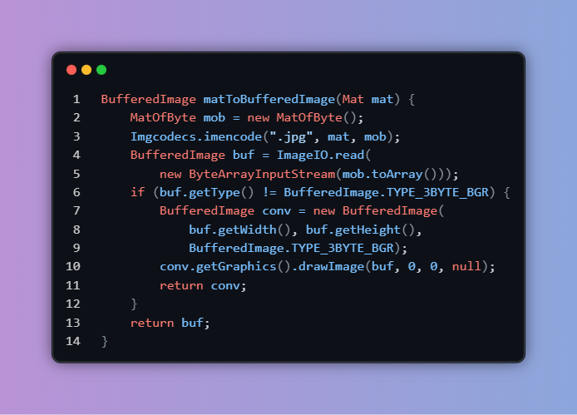
FilterFX
Home
About
Content
Others
VideoProcessor.java

Slide 10

FilterFX
Home
About
Content
Others
Speed-Up vs. Thread Count (DoG Filter on 4K Image)

Slide 11
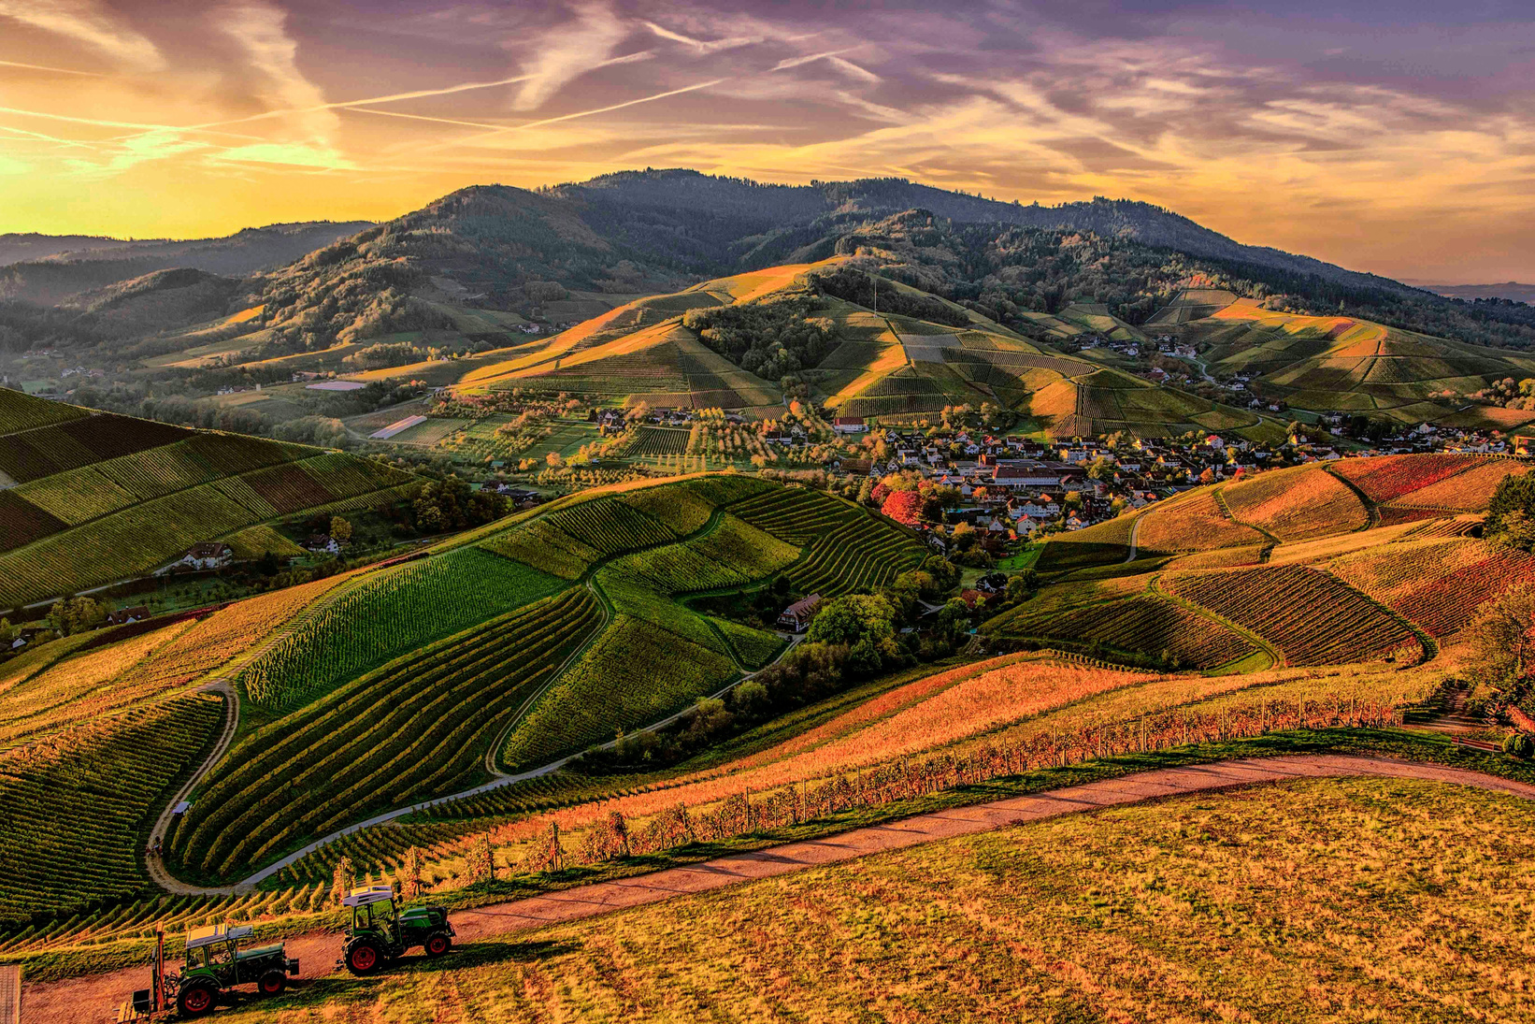
FilterFX
Home
About
Content
Others
Test Platform: 14-core laptop, 4 K input image
Filter: Difference-of-Gaussian (DoG)
Speed-Up vs. Thread Count (DoG Filter on 4K Image)

Slide 12
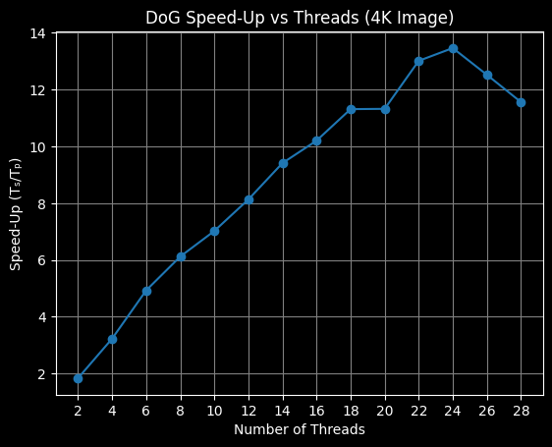
FilterFX
Home
About
Content
Others
Speed-Up vs. Thread Count (DoG Filter on 4K Image)

Slide 13
FilterFX
Home
About
Content
Others
Speed-Up vs. Image Resolution (DoG Filter)

Slide 14
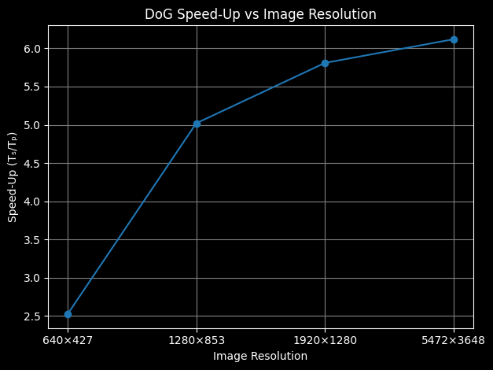
FilterFX
Home
About
Content
Others
Test Platform: 14-core laptop, 8 threads
Filter: Difference-of-Gaussian (DoG)
Speed-Up vs. Thread Count (DoG Filter on 4K Image)

Slide 15
FilterFX
Home
About
Content
Others
Thank You

